Slide 1
Question Answering
Summarization in Question Answering

Slide 2
Text Summarization
Goal: produce an abridged version of a text that contains information that is important or relevant to a user.
Summarization Applications
outlines or abstracts of any document, article, etc
summaries of email threads
action items from a meeting
simplifying text by compressing sentences

Slide 3
What to summarize? Single vs. multiple documents
Single-document summarization
Given a single document, produce
abstract
outline
headline
Multiple-document summarization
Given a group of documents, produce a gist of the content:
a series of news stories on the same event
a set of web pages about some topic or question

Slide 4
Query-focused Summarization & Generic Summarization
Generic summarization:
Summarize the content of a document
Query-focused summarization:
summarize a document with respect to an information need expressed in a user query.
a kind of complex question answering:
Answer a question by summarizing a document that has the information to construct the answer

Slide 5
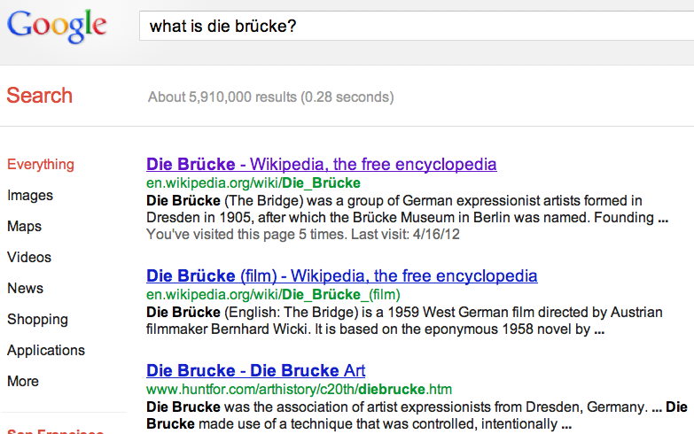
Summarization for Question Answering: Snippets
Create snippets summarizing a web page for a query
Google: 156 characters (about 26 words) plus title and link

Slide 6
Summarization for Question Answering: Multiple documents
Create answers to complex questions summarizing multiple documents.
Instead of giving a snippet for each document
Create a cohesive answer that combines information from each document

Slide 7
Extractive summarization & Abstractive summarization
Extractive summarization:
create the summary from phrases or sentences in the source document(s)
Abstractive summarization:
express the ideas in the source documents using (at least in part) different words

Slide 8
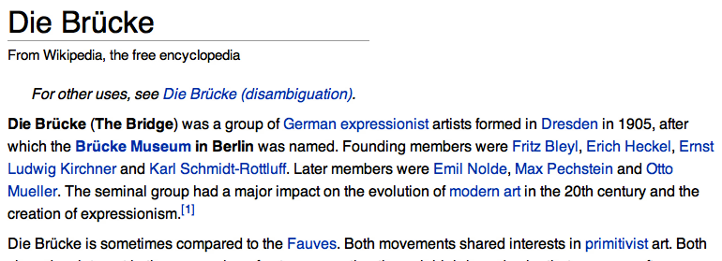
Simple baseline: take the first sentence

Slide 9
Question Answering
Summarization in Question Answering

